Slide 1
Group 7 Portfolio Analysis and Optimization
- Pruthvi Shaym Billa, Lakshita Garg, Satvik Narang, Kristina Sutliff, Thanmai Reddy Kadire

Slide 2
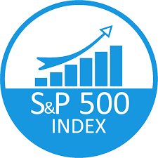


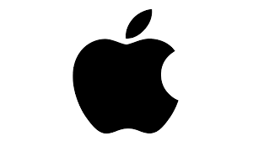






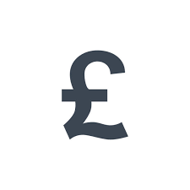


Slide 3
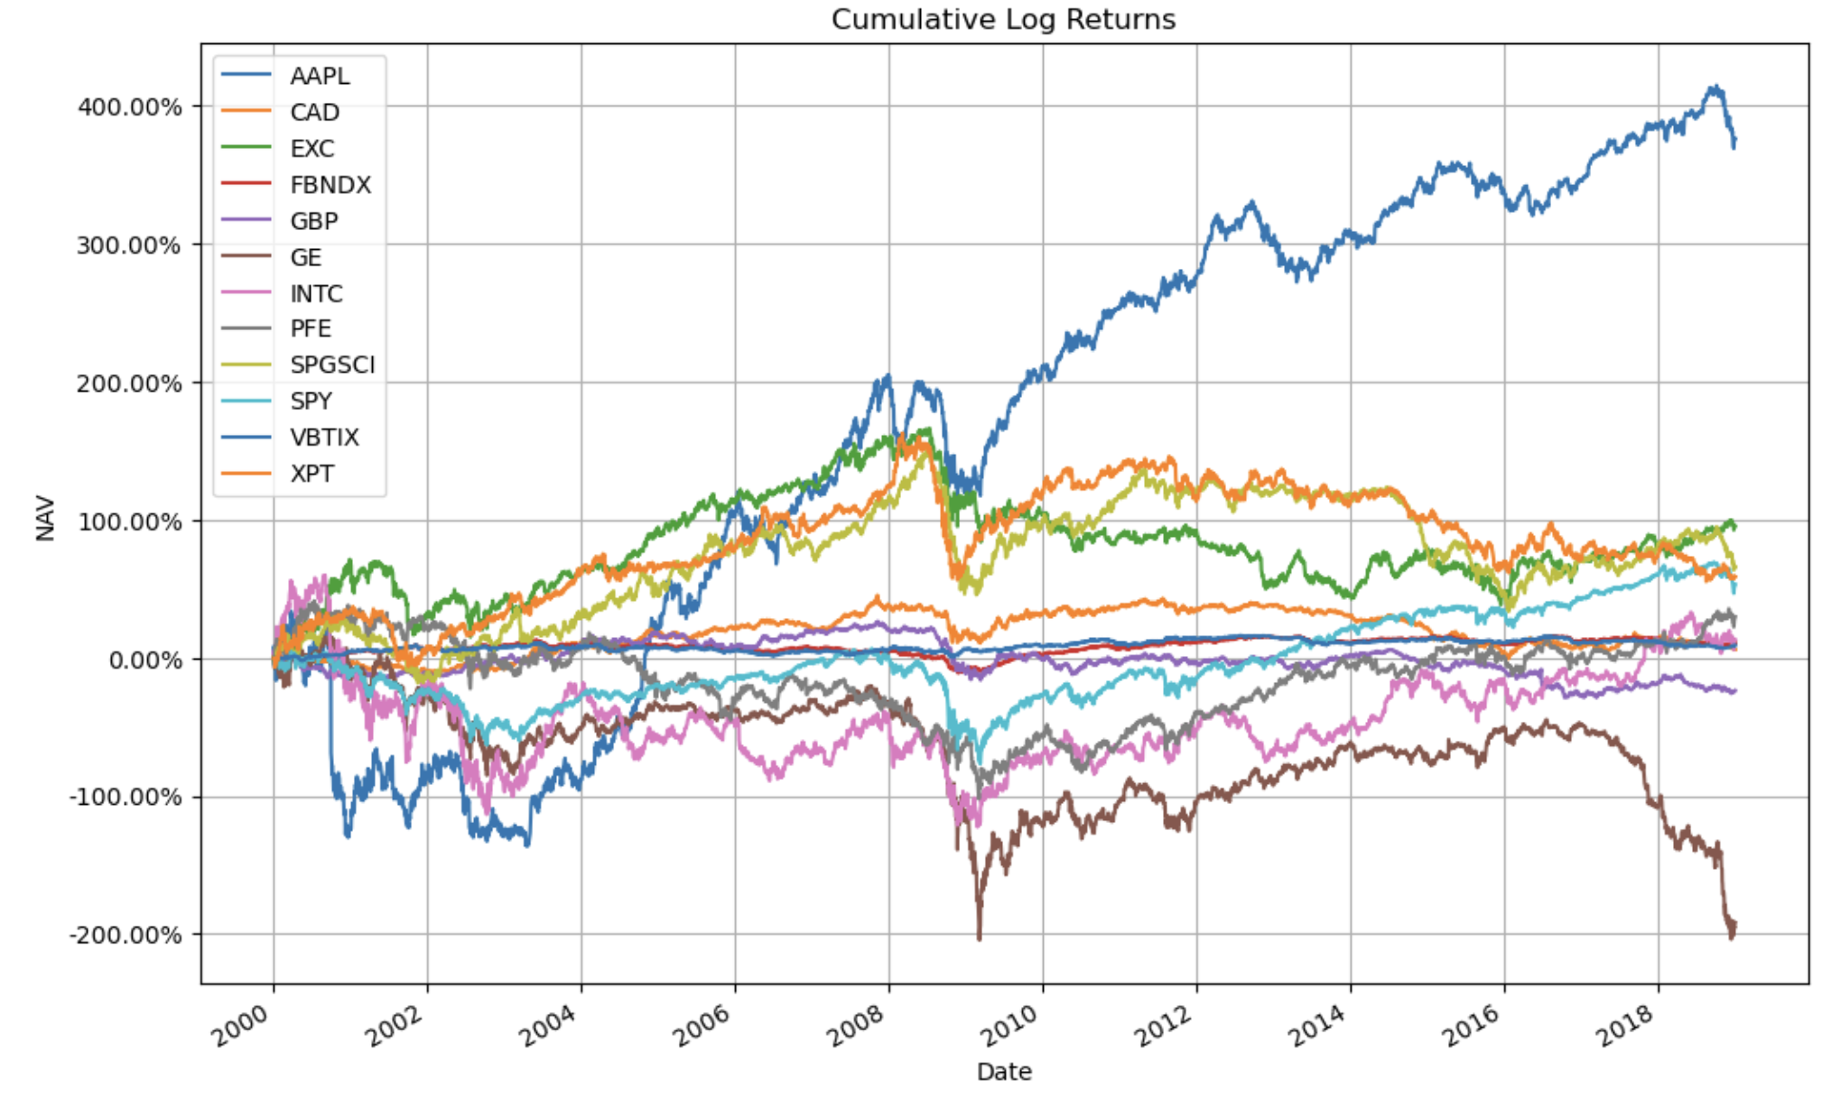
NAV Plots

Slide 4
Window Selection Analysis
Moving Averages(MA) strategy:
fastWindow = range(5, 110)
slowWindow = range(50, 500, 5)
Bollinger Bands strategy:
lookback_window = range(20, 50)
stdev_band = range(1, 4)

Slide 5
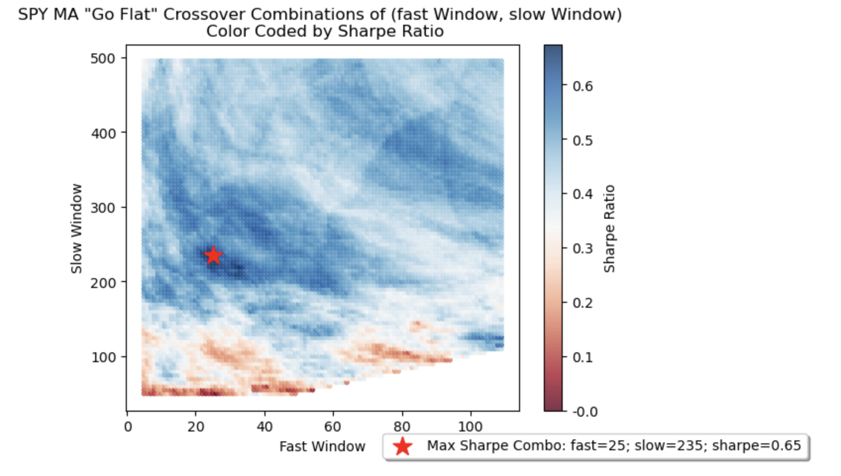
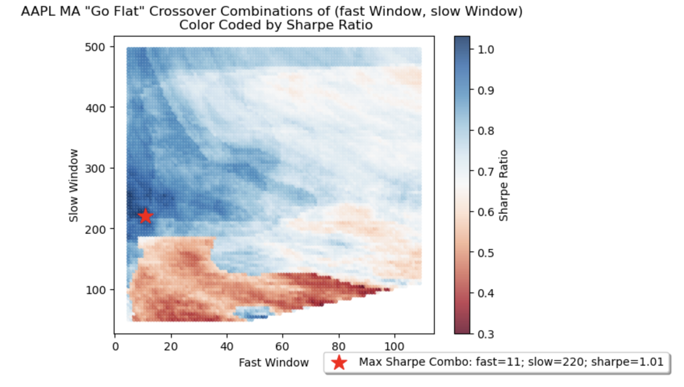
Moving Average Plots

Slide 6
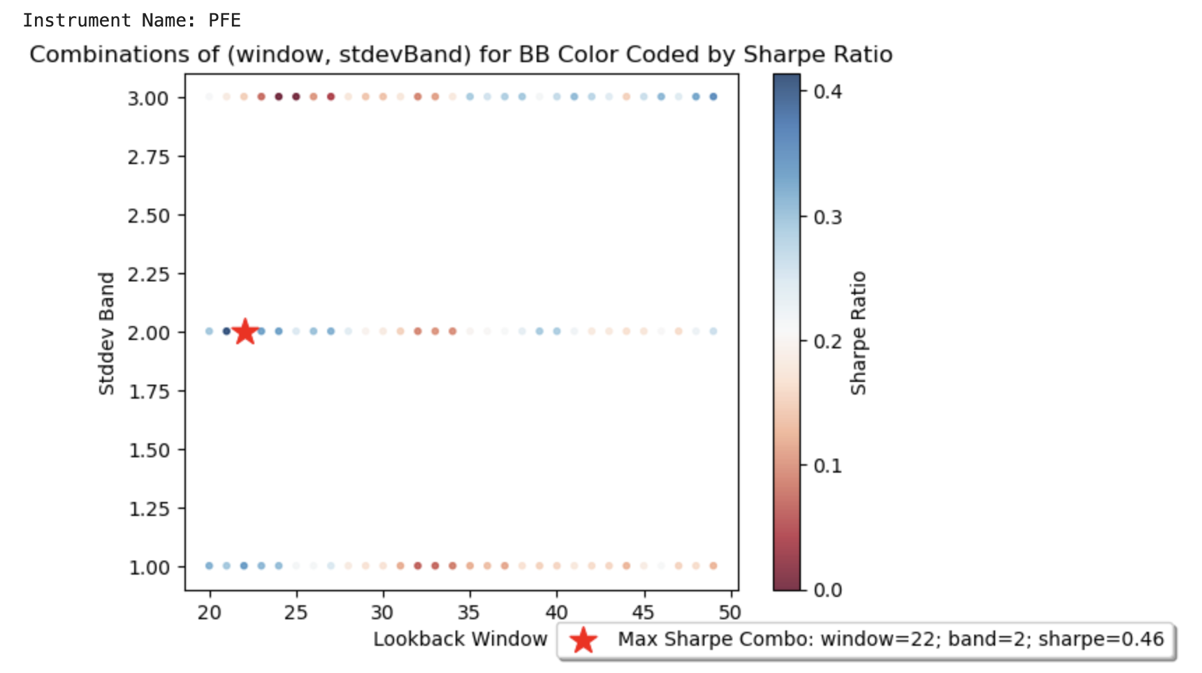
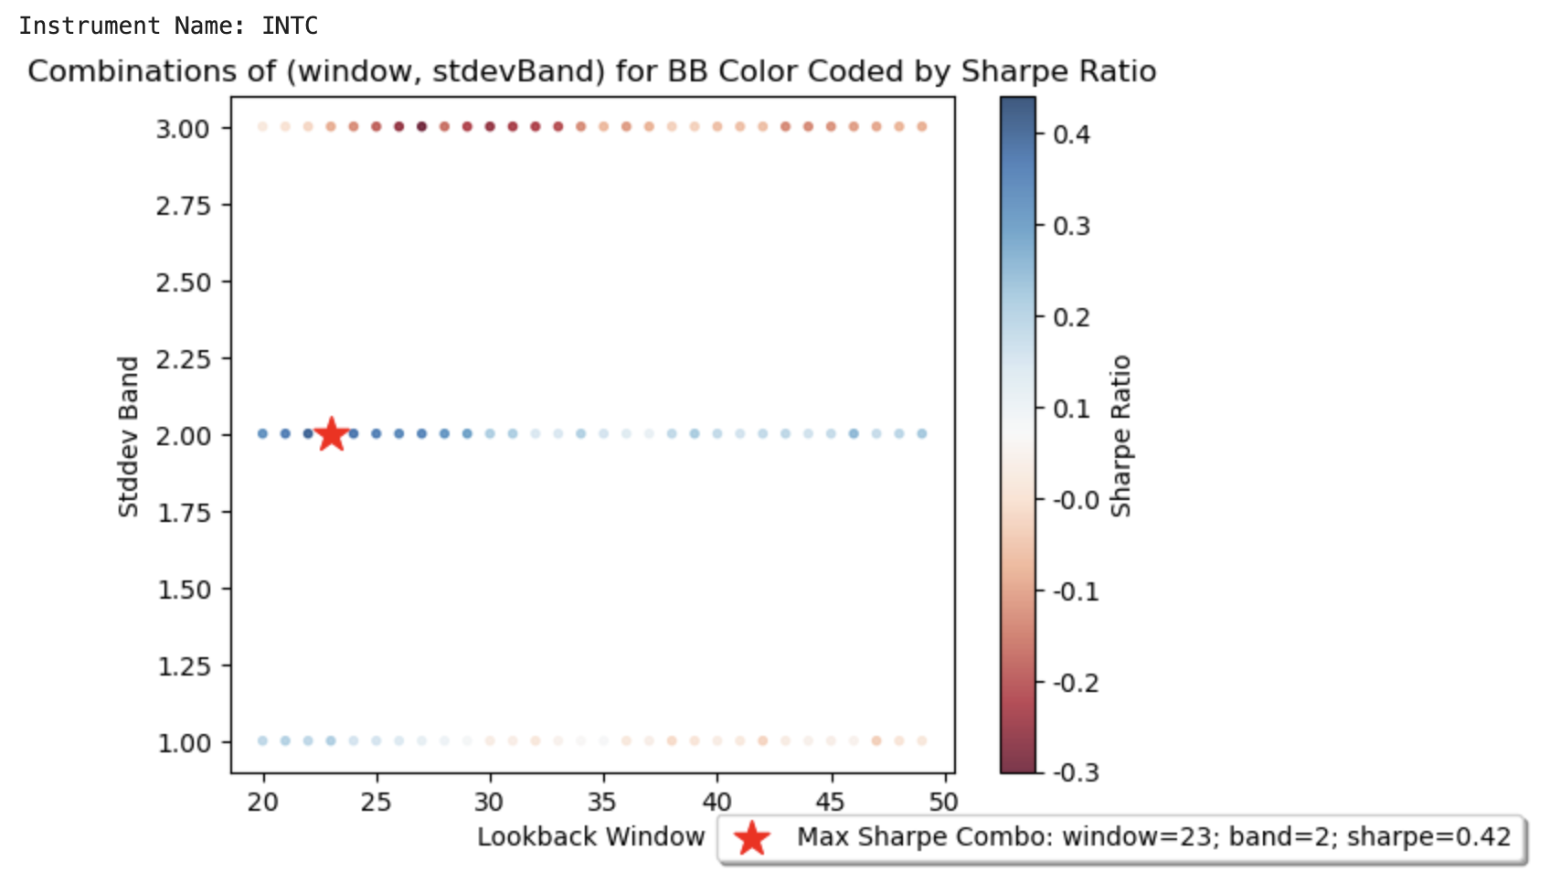
Bollinger Bands Plots

Slide 7
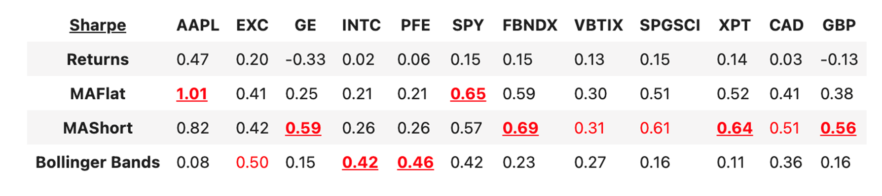
Chosen Strategies

Slide 8
Window Selection Results
Moving Averages(MA) strategy:
Equity: (fastWindow, slowWindow) = (11, 220)
Fixed income/Commodity/Currency: (fastWindow, slowWindow) = (93, 104)
Bollinger Bands strategy:
All instruments: (lookback_window, stdev_band) = (22, 2)

Slide 9
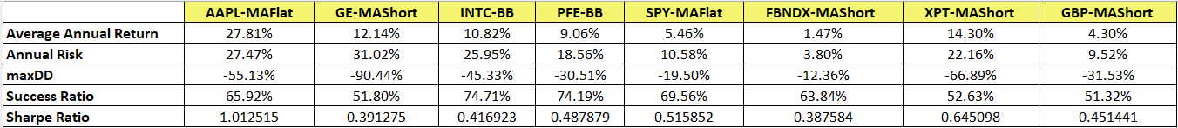
Performance Statistics of Portfolio Strategies
Inner join of the chosen strategies resulted in portfolio returns of 4560 rows (total rows of original df - largest window)

Slide 10
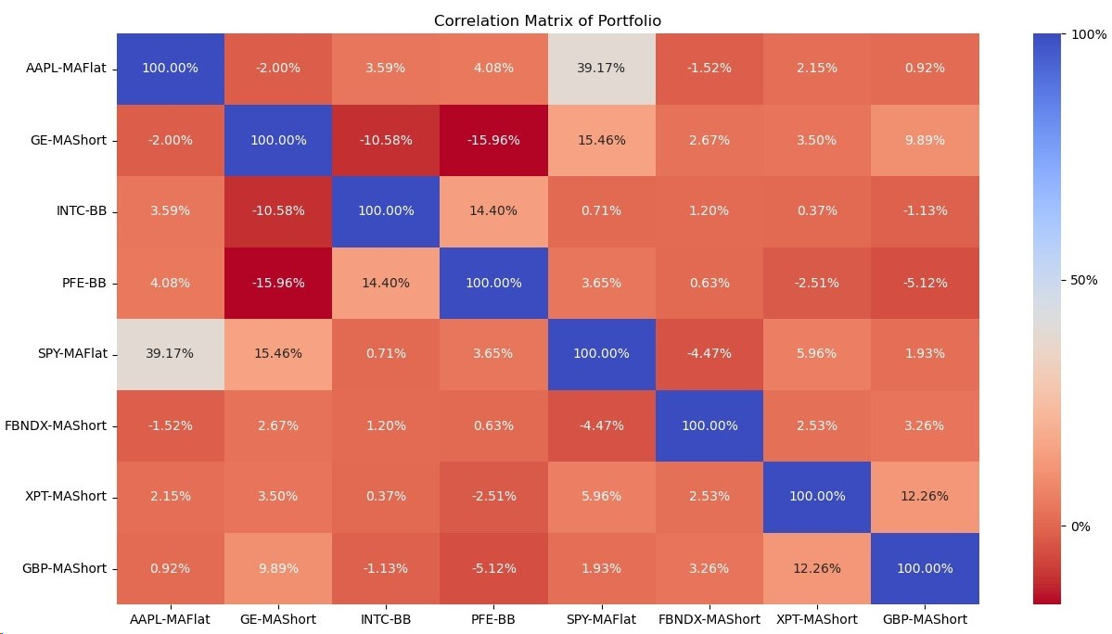
Correlation Structure
APPL-MAFlat and SPY-MAFlat are highly correlated with 39.17%.
GA-MAShort and PFE-BB are negatively correlated.

Slide 11
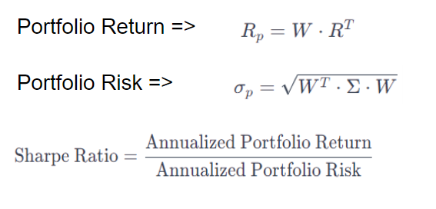
Equal Weights
The annualized sharpe of an equal weighted portfolio is 1.38.
Outperformance Insight:
The equal-weighted portfolio outperforms every individual strategy which indicates that, on a risk- adjusted basis, the portfolio is superior to investing in any single strategy alone.

Slide 12
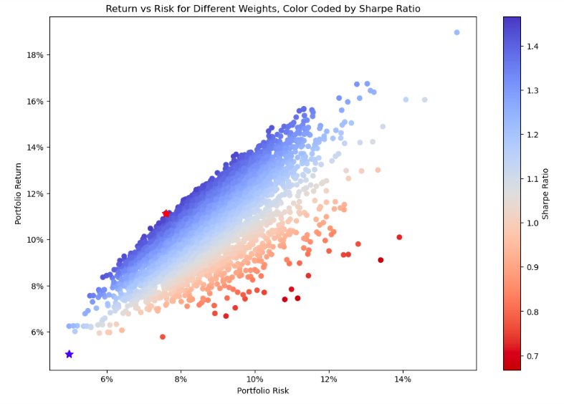
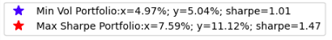
Return vs Risk for Different Weights

Slide 13
Weight Allocations
 | Minimum Volatility Portfolio | Maximum Sharpe Portfolio
AAPL-MAFlat | 0.21% | 17.14%
GE-MAShort | 1.96% | 7.62%
INTC-BB | 2.14% | 6.32%
PFE-BB | 2.02% | 17.25%
SPY-MAFlat | 27.56% | 3.78%
FBNDX-MAShort | 28.49% | 16.81%
XPT-MAShort | 7.9% | 13.94%
GBP-Short | 29.72% | 17.11%

Slide 14
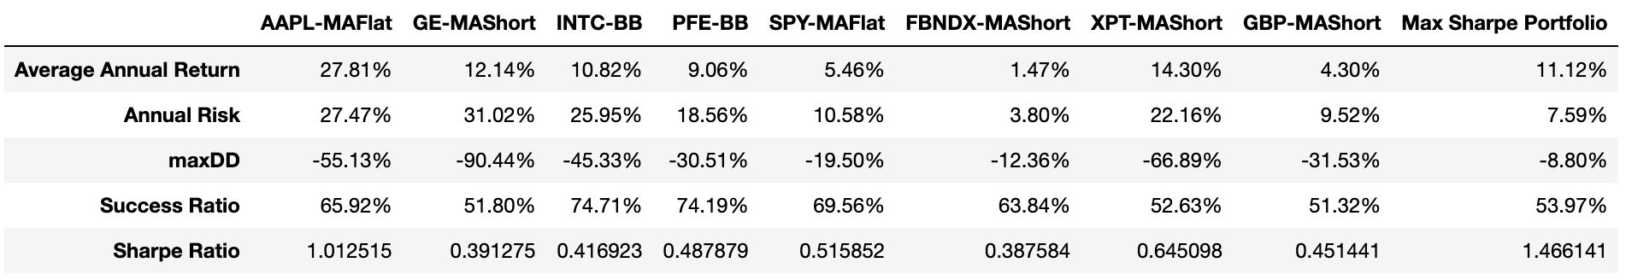
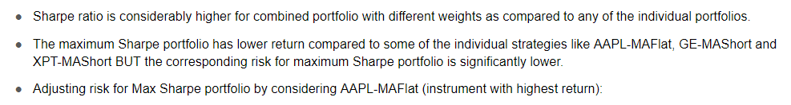
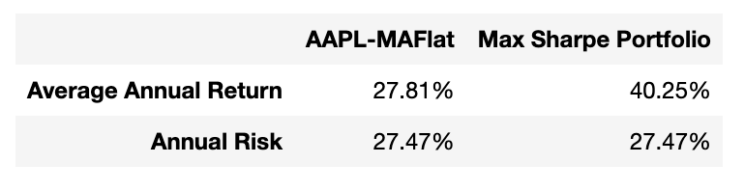
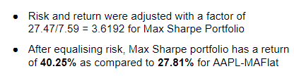
Max Sharpe Portfolio VS Individual Strategies

Slide 15
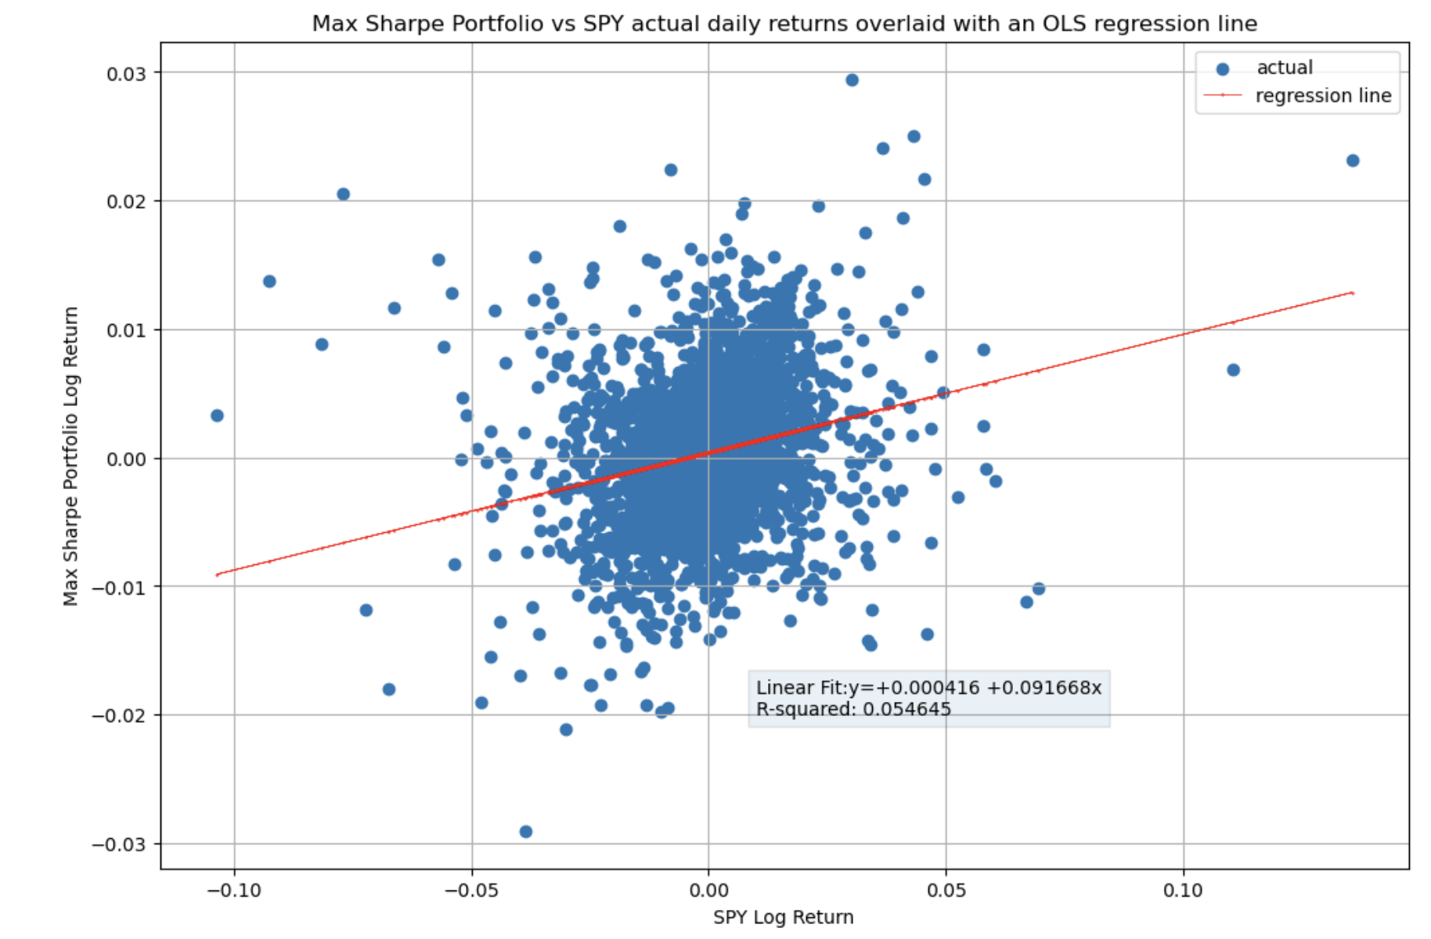
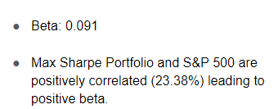
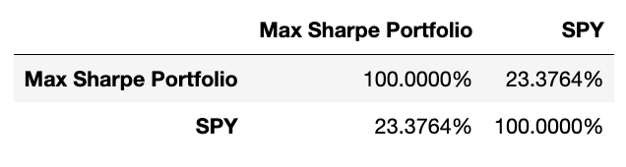
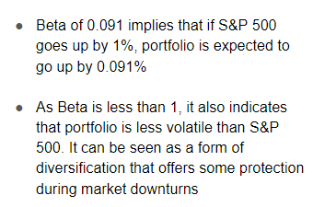
Beta of Max Sharpe Portfolio to the S&P 500

Slide 16
Equal Weighted Portfolio
Variations of the equal weighted portfolio containing the 8 instruments:
Sharpe of an equal-weighted Benchmark portfolio : 0.186
Sharpe of an equal-weighted MAFlat portfolio : 0.621
Sharpe of an equal-weighted MAShort portfolio : 0.436
Sharpe of an equal-weighted BB portfolio : 0.062
None of these 4 portfolios outperform the chosen Max Sharpe Portfolio of 1.47

Slide 17
THANK YOU

